Slide 1
Blood group detection system
Guided by-
Prof. Ms. A. A. Gat

Slide 2
Team members
Poonam Gajanan Babar 18UCS001
Prajakta Madhukar Chothe 18UCS014
Pooja Vilas Jadhav 18UCS029
Shivani Sunil Kamble 18UCS036

Slide 3
Introduction
Detection of blood group is an essential factor in critical conditions before performing blood transfer.
At presently tests are conducted by lab technicians manually in laboratory. Which is time consuming and may introduce human error while detecting blood type.
The research survey proposal is to reduce the physical work to identify the blood group using image processing technique.

Slide 4
Problem Statement
To implement Blood Group detection system by using image of blood sample.

Slide 5
Problem Description
It is very important to determine the blood type quickly and accurately in an emergency before transfusion.
Today, rapid blood typing methods based on image recognition technology are widely used in automated blood detection.
This project proposes a fast, accurate, and robust blood group analysis method based on the imaging function of the ABO high-speed blood group analyzer.
Experimental results shows that this method can quickly and accurately classify ABO blood groups.

Slide 6
Objective
1. To preprocess the blood drop images.
2. To implement a model for identifying blood group is A, B, AB or O (Positive or Negative) category.
3. To provide results within the shortest possible time along with storage of result for further use.

Slide 7
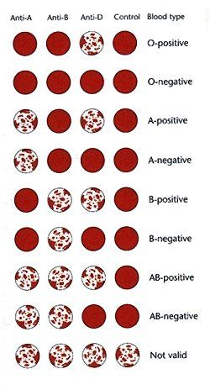
Blood Group detection chart

Slide 8
Modules
Login :
In Login module lab assistant can login to the system with valid login credential.
Registration :
There are two types of registration employee and patient registration.
A. Employee registration:
Lab assistant can add new employee with valid information.
B. Patient registration:
Lab assistant can register patient to detect the blood group with valid information.

Slide 9
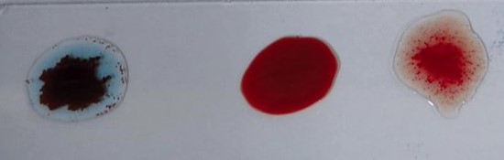
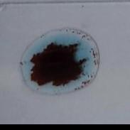
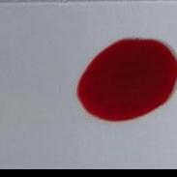
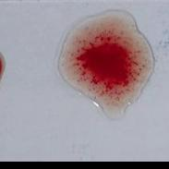
Modules
Detection:
Detection module has three sub modules
A. Select slide:
Lab assistant select blood slide image for further processing.
B. Split image:
In this module system splits blood slide image into three sub images.

Slide 10
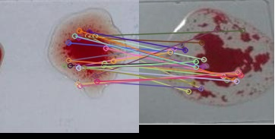
Modules
C. Image Matching (SIFT or ORB):
In this module system detect Key points and computes descriptors of split image and standard image. then match the spited image and standard image by using descriptors and find out matching points between images .With help of matching points detect the blood group.

Slide 11
Modules
4. Prediction:
In this module trained model is loaded and selected image is tested with trained model.
5. Email:
In this module detected blood group information is send to particular patient through email.

Slide 12
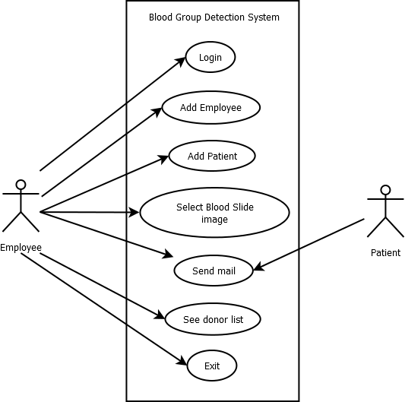
Use case diagram

Slide 13
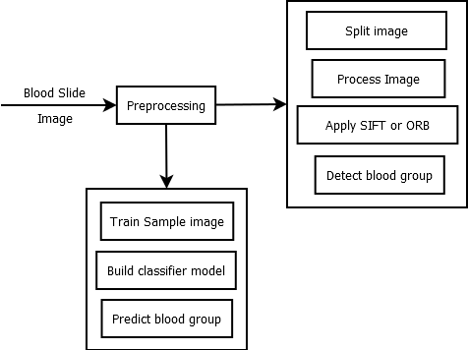
Architecture diagram

Slide 14
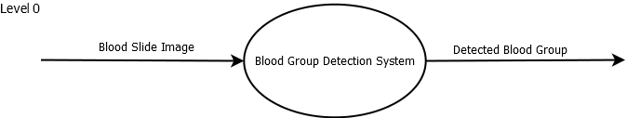
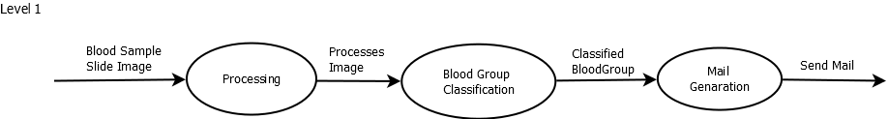
Dataflow Diagram

Slide 15
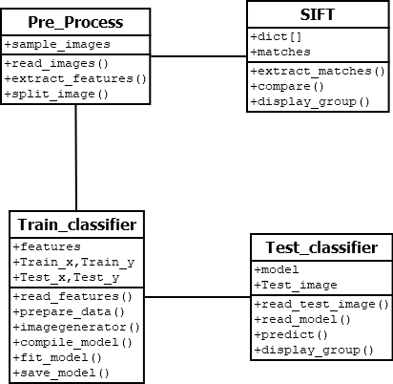
Class diagram

Slide 16
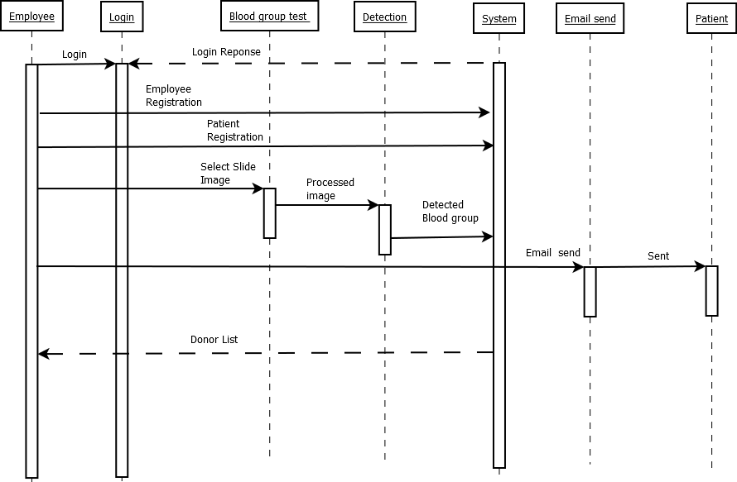
Sequence Diagram

Slide 17
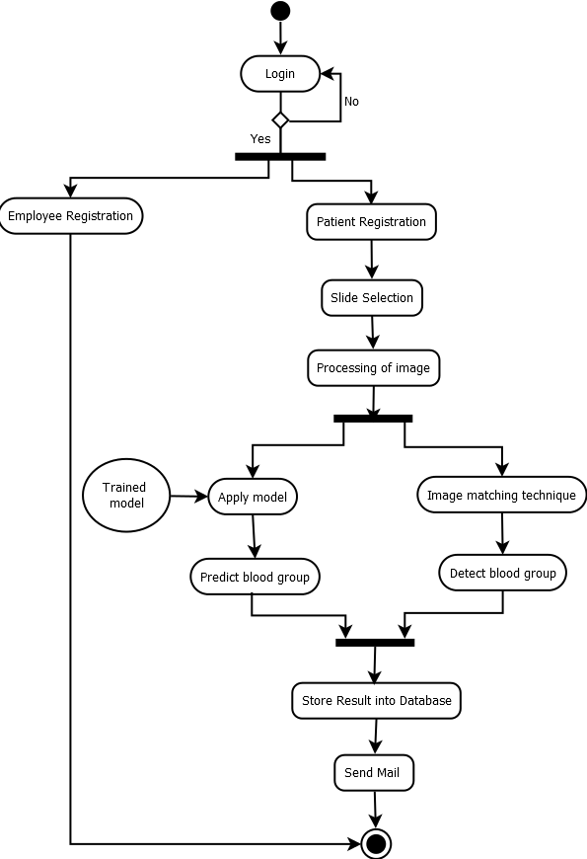
Activity diagram

Slide 18
Reference
[1] MedlinePlus-Health Information from the National Library of medicine https://medlineplus.gov/ency/article/003345.html .
[2] Mehedi Talukdar, Md Rabiul Islam, Md. Mahfuz Reza, Mahbuba Begum, Md. Mahmudul Hasan, “Improvement of Accuracy of Human Blood Groups Determination using Image processing Techniques”, International Journal of Advanced Research in Computer and Communication Engineering. Vol. 4 Issue 10, October 2015.
[3] S. M. Nazia Fathima, “Classification of Blood Types by Microscopic Color Images”, International Journal of Machine Learning and Computing. Vol. 3, No 4, August 2013.
[4] Enes Ayan, Erdem Kamil Yildirim, “Real Time Blood Type Determination by Gel Test Method on an Embedded System”, International Journal of Applied Mathematics, Electronic and Computers. Vol 4, September 2016.
[5] Anurag Sadashiv Phad, Tejas Sanjay Targhale, Bharat Bhalshankar, Sunita Kulkurni, “Blood Group Detection by Using Raspberry Pi-3”, International Journal of Advanced Research in Electronics and Communication Engineering (IJARECE). Vol 7, Issue 4, April 2018.
[6] Mansi K, Hitashree M., Chandana Lakshman Hegdepaper, “Blood Group Determination through Medical Image Processing”, International Journal for Research in Applied Science and Engineering Technology. Vol 9, Issue v, May 2021.
[7] Nuha Odeh, Anas Toma, Falah Mohammed, “An Efficient system for Automatic Blood Type Determination Based on image Matching Techniques”, MDPI stays neutral with regard to jurisdictional claims in published maps and institutional affiliations. Vol 11, June 2021

Slide 19
Thank You

